Slide 1
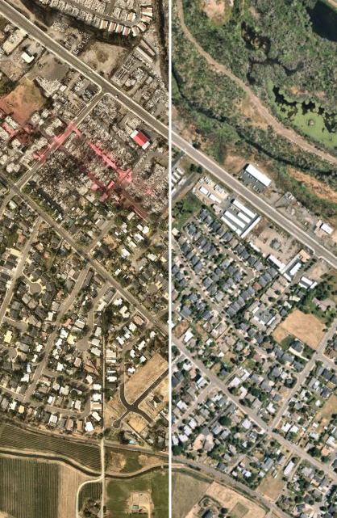
Urban Renewal Plan to Recover and Revitalize after the Almeda Fire
Presentation FOR PTSD Board 3/15/2023

Slide 2
UR consideration process
45-day public review period
Drafting of Plan
Purpose
Planning Commission Review
Jackson County Board Review
Public Hearing
Vote to Refer to the Ballot
Public Vote
Final Adoption
(if approved)
Projects
Boundary
Financial Analysis
Initial Plan
Public Feedback
Edits to Plan
Consideration for Adoption
denotes where we are in the consideration process

Slide 3
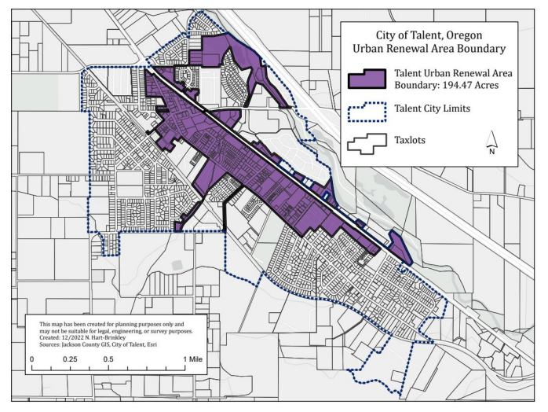
URBAN RENEWAL AREA
Shady Brooks Mobile Estates has been removed from the District

Slide 4
URBAN RENEWAL GOALS
Recover affordable housing. Increase available, buildable land and decrease the cost of building affordable housing.
Revitalize commercial areas. Encourage commercial property development and support business development.
Upgrade city infrastructure. Perform neighborhood-specific investments to support high-density housing and capital projects that support increased demand on entire system.
Increase resiliency and decrease risk. Improve our response to and decrease risk of emergencies in the future.

Slide 5
URBAN RENEWAL Projects
Total cost of these projects is estimated at $11.6 million
Rapp Road Sidewalk Improvements
Wintersage Upgrade to Local Street Standards
Rapp Road Railroad Crossing Improvements
Gangnes Neighborhood Storm Drain Improvements
Fire flow improvement
Neighborhood-specific infrastructure
Assessment of publicly owned properties for development
Affordable Housing Incentive Program
Economic Development Incentive Program
Tree Planting Program
Wagner Creek/Bear Creek Walking Paths
Seismic Pipe Upgrades
Shake Alert for Water Distribution System
Emergency Warning and Response System

Slide 6
TAX INCREMENT FINANCING
Jan. 2020
Jan. 2021
Jan. 2022
Jan. 2023
Jan. 2024…
$2,000
$2,060
$2,122
$2,185
$2, 251
$2,000
$1,000
$1,800
$3,500
$3,605
$800
$824
$849
$874
$900

Slide 7
Freeze Date
TAX INCREMENT FINANCING
In Urban Renewal Area
Jan. 2020
Jan. 2021
Jan. 2022
Jan. 2023
Jan. 2024…
$2,000
$2,060
$2,122
$2,185
$2, 251
$2,000
$1,000
$1,800
$3,500
$3,605
$800
$824
$849
$874
$900

Slide 8
Freeze Date
TAX INCREMENT FINANCING
In Urban Renewal Area
Jan. 2020
Jan. 2021
Jan. 2022
Jan. 2023
Jan. 2024…
$2,000
$2,060
$2,122
$2,185
$2, 251
($73)
($129)
$2,000
$1,000
$1,800
$3,500
$3,605
($1,700)
($1,805)
$800
$824
$849
$874
$900
($25)
($51)
$4,771
$4,771
($1,798)
($3,685)

Slide 9
TAX INCREMENT FINANCING
The amount of property taxes an owner pays does not change
Where the property tax revenue is allocated to changes.
The reallocation only occurs to properties within the district.
Any reallocated revenue can only be spent within the district.

Slide 10
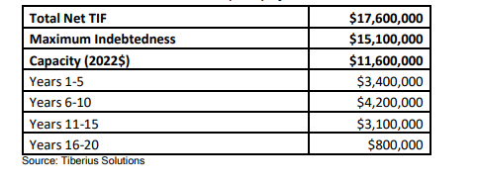
TAX INCREMENT FINANCING
These numbers are changing based on changes to the Plan

Slide 11
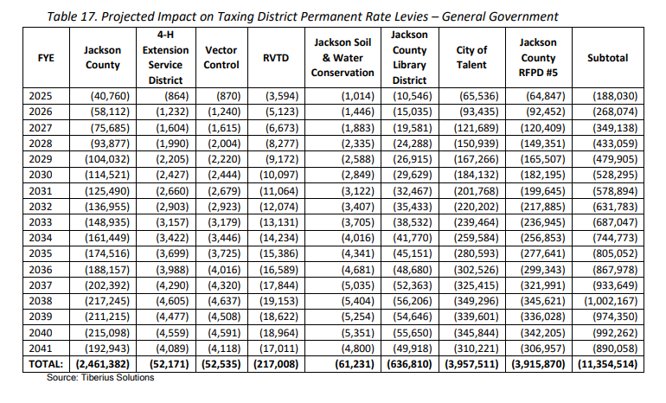
IMPACT TO OTHER TAXING DISTRICTS
These numbers are changing based on changes to the Plan

Slide 12
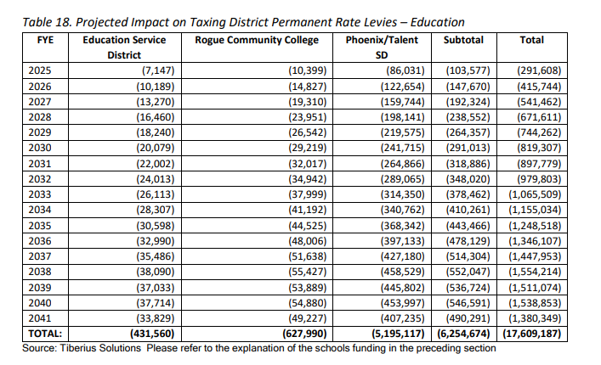
IMPACT TO OTHER TAXING DISTRICTS
These numbers are changing based on changes to the Plan

Slide 13
WHAT WE’VE HEARD SO FAR

Slide 14
Letters We’ve Received
Concern for how the previous urban renewal acted
Appoint an independent Board of Directors (2)
More strongly align the plan and plan language with social-equity values (2)
Remove Shady Brook Mobile Estates (2)
Tie changes to the plan to public approval
Comments on the order of priority for the goals
Delay implementation of the plan & make further refinements (3)
Reduce fiscal impacts to other agencies
Slow down & Protect the Fire District
Pass the proposed plan (3)
Place both versions of the plans on the May 2023 ballots
Do not adopt urban renewal in general (2)

Slide 15
CHANGES MADE TO THE PLAN
Delay the “freeze date” to January 2023 assessed values.
Require an advisory vote for any increase to maximum indebtedness
Remove Shady Brook Mobile Estates from the district area
Make edits to the language in the plan to clarify what affordable housing is and who the plan is most intended to serve

Slide 16
UR consideration process
Updating the Plan with changes
45-day public review period
Drafting of Plan
Purpose
Planning Commission Review
Jackson County Board Review
Public Hearing
Vote to Refer to the Ballot
Public Vote
Final Adoption
(if approved)
Projects
Boundary
Financial Analysis
Initial Plan
Public Feedback
Edits to Plan
Consideration for Adoption
denotes where we are in the consideration process

Slide 17
Urban Renewal Plan to Recover and Revitalize after the Almeda Fire

